Slide 1
SUSE® Presentation (32pt)
Guidelines and Template (16pt)
Presenter’s Name (11pt) Title Company/Email

Slide 2
SUSE Presentations
Welcome to the SUSE presentation guidelines. The following information will be covered:
Guidelines (slides 3–8)
Basic Slide Layout
Template Instructions
Color Palette
Graphics and Typeface
Editorial Guidelines
Slide Trademarking Guidelines
Presentation Template (slides 9–17)

Slide 3
Basic Slide Layout – Slide Title Here (28pt)
First level bullet (18pt)
Second level bullet (14pt)
Third level bullet (12pt)
Fourth level bullet (11pt)
Fifth level bullet (10pt)

Slide 4
Template Instructions
This slide outlines the basic guidelines and instructions to help you use the SUSE presentation template.
Delete slides (1–8) before projecting, presenting or sending to anyone.
When inserting slides from other presentations, you will need to go to the template's master page and update each inserted slide so it reflects the slides in this template.
If you are converting charts and diagrams from Microsoft PowerPoint to LibreOffice, you may not be able to edit them once they are in the .ODP format. If this is the case, the graphic must be recreated.
The goal of this template is to maintain a clear, professional and consistent tone and appearance among all SUSE presentations. The default text boxes in the presentation represent the margins or “working area” to which all text, graphics and diagrams should conform. These margins are not arbitrary, and they are not meant to constrict creativity; when used correctly, they keep the slides focused and leave enough white space so audiences can easily digest the presented material. If you need more room than the margins allow, we suggest moving content to another slide.

Slide 5
Color Palette
SUSE Green
Dark
Blue
Colors: Approved RGB colors for SUSE presentations have been outlined to ensure color accuracy.
RGB
2, 211, 95
RGB
13, 44, 64
Bright Green
Medium Green
Bright Teal
Light Blue
Bright Blue
Bright Royal
Dark Purple
Bright Purple
Bright
Magenta
Light
Magenta
RGB
160, 255, 95
RGB
0, 192, 129
RGB
2, 164, 156
RGB
112, 214, 224
RGB
0,178, 226
RGB
0, 7, 176
RGB
20, 25, 105
RGB
132, 23, 129
RGB
222, 0, 128
RGB
247, 163, 213
Dark Orange
Medium Orange
Light
Yellow
Dark Neutral
MD/Dark Neutral
Medium Neutral
Light Neutral
Tint Neutral
RGB
237, 105, 36
RGB
253, 154, 43
RGB
255, 239, 141
RGB
0, 0, 0
RGB
95, 95, 95
RGB
167, 169, 172
RGB
220, 221, 222
RGB
237, 237, 237
For more information on SUSE color palette guidelines, visit www.suse.com/brandcentral

Slide 6
Graphics and Typeface
Outline
Icons: Icon libraries are available for download in outline and filled-in designs. The primary color for SUSE is green.
Typeface: Arial is the typeface for all SUSE presentations.
Download the complete icon library by visiting:
Brand Central ›
Encapsulated Outline
Filled
Encapsulated Filled

Slide 7
Editorial Guidelines
To help you achieve a consistent, professional message, general guidelines about SUSE style and grammar usage are outlined below.
Acronyms: Acronyms may be used for industry terms provided you spell out the terms at first reference in body copy. Tables and charts are an exception when real estate is limited. Example: The Independent Software Vendor (ISV) solution …
NEVER abbreviate product names in external presentations.
Capitalization: The title of the presentation and the title and subtitle of each slide are the only elements that should be capitalized in title case. All other elements should be capitalized in sentence case (only the first word of each sentence capitalized). This includes bullet points, call outs, emphasized words, table headings and captions.
Hyphenated compounds within titles: If a hyphenated compound appears in a title, lowercase the word following the hyphen; for example, “Low-cost Alternatives.”
Bulleted lists: To set off the lead text in bulleted lists (the words “Bulleted lists” in this case), use colons. Try to keep information presented in bulleted lists short, so it is easy for audiences to consume.
Punctuation within bulleted lists: Be consistent when punctuating bulleted lists. For example, if you choose to use a complete sentence in the first bullet, use complete sentences, and punctuate accordingly for all bullets on that slide.
General punctuation: Use “and” instead of “&” except in proper names (e.g., AT&T). Write out percent signs. Tables and charts are the exception when real estate is limited.

Slide 8
Slide Trademarking Guidelines
The following guidelines are basic rules for product naming and trademarking:
Product naming: Use the full legal product name at all references within the presentation; no product acronyms or abbreviations are allowed.
Product trademarking: SUSE® products and selected technologies should be trademarked at first reference on each slide. This will help us legally protect these marks.
Third-party trademarking: Except for Micro Focus®, SUSE does not reference third-party trademarks.
Trademark design: Trademarks should be large enough to be recognized, but small enough so they do not distract from the content.
Trademark placement: The registered trademark symbol (®) should go on the baseline of the text. The trademark and service mark symbols (™, SM) should be arranged so that the top of the symbol is level with the top of the last letter of the word being marked.

Slide 9
Intro to Alchemy: Convert Existing Workloads to Gold-Master Images
HO126888
Wayne Patton – SUSE – Technical Account Manager Rick Ashford – SUSE – Sales Engineering Manager

Slide 10

Agenda Hands On
Inspect System with Machinery
Overview of Machinery Data
Machinery export to html
Machinery Export to KIWI
Build new image with KIWI
Run image
Modify image data
Rebuild with KIWI
Run image
Sandbox time
What is Machinery?
What is KIWI?
What problem is solved?
Common Use Case(s)

Slide 11

Converting Workloads
Move a system from platform to platform (physical or virtual)
Move a system to the cloud
Define a base system that’s repeatable

Slide 12
Converting Workloads
Move a system from platform to platform (physical or virtual)
Move a system to the cloud
Define a base system that’s repeatable
Machinery – Will inspect a system creating a system description
KIWI – Tool used to build a system image

Slide 13

What is Machinery?
http://machinery-project.org/
A command line application for creating and working with system descriptions

Slide 14
What is Machinery?
http://machinery-project.org/
A command line application for creating and working with system descriptions
Discover configuration
Inspect a system
Extract configuration information into various output formats

Slide 15
What is Machinery?
http://machinery-project.org/
A command line application for creating and working with system descriptions
Discover configuration
Inspect a system
Extract configuration information into various output formats
Validate Systems
Compare against known good state
Track changes over time

Slide 16
What is Machinery?
http://machinery-project.org/
A command line application for creating and working with system descriptions
Discover configuration
Inspect a system
Extract configuration information into various output formats
Validate Systems
Compare against known good state
Track changes over time
Uses ssh key for accessing inspected systems

Slide 17
Machinery Use Case
Creating system description
Export inspection data (ie: KIWI or HTML)
Compare system descriptions
Same system different time
Different systems
Example – Several web servers are supposed to be the same but one isn’t acting correctly
Physical to Cloud
Migrate SLE 11 to SLE 12

Slide 18
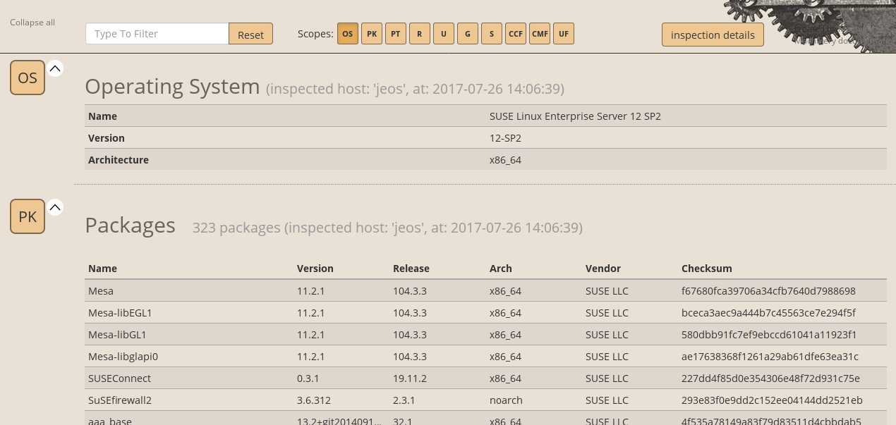
Machinery html output example

Slide 19
Machinery compare example
srv:~ # machinery inspect jeos
srv:~ # machinery copy jeos jeos.orig
Install apache on jeos
Create index.html on jeos
srv:~ # machinery inspect jeos
srv:~ # machinery compare jeos.orig jeos
# Packages
Only in 'jeos':
* apache2, * apache2-prefork
* apache2-utils, * libapr-util1
* libapr1, * liblua5_2
* libnghttp2-14
# Services
Only in 'jeos':
* apache2.service: disabled
* apache2@.service: disabled
# Unmanaged Files
Only in 'jeos':
* /etc/sysconfig/apache2 (file)
* /srv/www/htdocs/index.html (file)
* /usr/sbin/httpd (link)
* /var/lib/systemd/migrated/apache2 (file)

Slide 20

What is KIWI?
Tool for building Linux system images
SUSE Studio uses it as back-end
openSUSE Build Service
SUSE Products are built with KIWI
Included and fully supported in SUSE Enterprise Linux. (SLES)

Slide 21
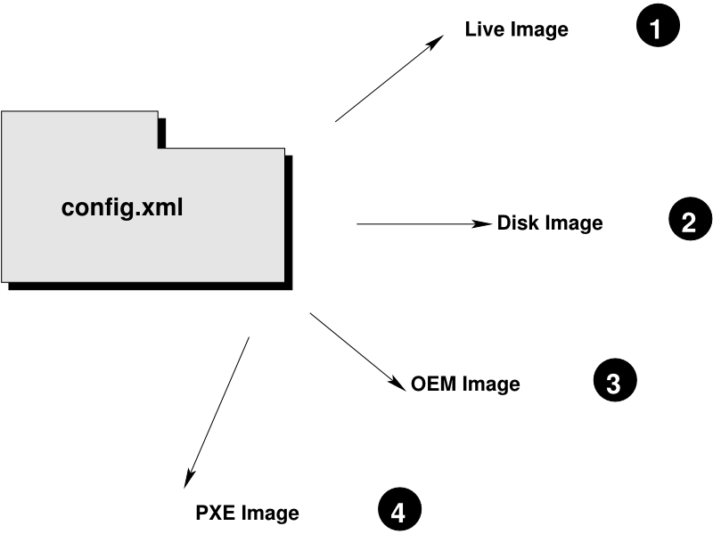
What is KIWI?
Tool for building Linux system images
SUSE Studio uses it as back-end
openSUSE Build Service
SUSE Products are built with KIWI
Included and fully supported in SUSE Enterprise Linux. (SLES)
Output many formats:

Slide 22
What is KIWI?
Tool for building Linux system images
SUSE Studio uses it as back-end
openSUSE Build Service
SUSE Products are built with KIWI
Included and fully supported in SUSE Enterprise Linux. (SLES)
Output many formats:
ISO Live CD/DVD
PXEBoot Hard Disk
USB Amazon EC2 (.ami)
Docker Google Cloud Format (..gce)
VMware (.vmdk) XEN
Vagrant (.vagrant)
VirtualBox (.vdi)
Virtual Hard Disk (.vhd)
KVM/Qemu (.qcow2)
Open Virtualization Format (.ovf, .ova)

Slide 23
KIWI Process
KIWI process is divided into two stages
Preparation:
Create a root file system defined by configuration file.
Installs packages into the filesystem
Results in unpacked root tree

Slide 24
KIWI Process
KIWI process is divided into two stages
Preparation:
Create a root file system defined by configuration file.
Installs packages into the filesystem
Results in unpacked root tree
Creation:
desired image is created from the directory structure
https://doc.opensuse.org/projects/kiwi/doc/

Slide 25

Lab – What are we going to do?
Use machinery to inspect a VM.
Explore the Universal System Description
Export the description to KIWI
Use KIWI to replicate original system
Run the VM
Modify KIWI configuration, re-build and run
Use machinery to compare configuations

Slide 26
Lab
Open Intro-to-Alchemy.pdf
Text with grey background represents commands to type
You will be logged in as root!
Passwords = “linux”

Slide 29
Section Title (28pt)

Slide 30
Section Title (28pt)

Slide 31
Section Title (28pt)

Slide 32
Section Title (28pt)

Slide 34
Unpublished Work of SUSE LLC. All Rights Reserved.
This work is an unpublished work and contains confidential, proprietary and trade secret information of SUSE LLC. Access to this work is restricted to SUSE employees who have a need to know to perform tasks within the scope of their assignments. No part of this work may be practiced, performed, copied, distributed, revised, modified, translated, abridged, condensed, expanded, collected, or adapted without the prior written consent of SUSE. Any use or exploitation of this work without authorization could subject the perpetrator to criminal and civil liability.
General Disclaimer
This document is not to be construed as a promise by any participating company to develop, deliver, or market a product. It is not a commitment to deliver any material, code, or functionality, and should not be relied upon in making purchasing decisions. SUSE makes no representations or warranties with respect to the contents of this document, and specifically disclaims any express or implied warranties of merchantability or fitness for any particular purpose. The development, release, and timing of features or functionality described for SUSE products remains at the sole discretion of SUSE. Further, SUSE reserves the right to revise this document and to make changes to its content, at any time, without obligation to notify any person or entity of such revisions or changes. All SUSE marks referenced in this presentation are trademarks or registered trademarks of Novell, Inc. in the United States and other countries. All third-party trademarks are the property of their respective owners.

